Slide 1

Unit – 1 Introduction to SQL
Database Management System (DBMS-I)
DU # 2301CS302
Prof. Dixita B. Kagathara
Computer Engineering Department
dixita.kagathara@darshan.ac.in
+91 - 97277 47317 (CE Department)

Slide 2
Topics to be covered
Database Concepts (Database, Table, Column, Row)
Data types in SQL
Types of SQL Commands (DDL, DML, DQL, DCL, and TCL)
SQL Commands (CREATE, INSERT, SELECT, ALTER, UPDATE, DELETE, TRUNCATE, DROP)
Operators
Like Predicate
Aggregate Functions
Group By and Having
Order By Clause
SQL in-built Functions
Constraints & Keys

Looping

Slide 3
Why DBMS?

Slide 4



Parts of an Application
Application
Front end
Back end
User directly interact with Application is called front end.
User can’t directly interact with Application is called back end.
User can view front end.
User can’t view back end.
Tool used to develop front end: HTML, CSS, JavaScript etc.
Tool used to develop back end: languages (Java, PHP) + Database (SQL server, Oracle)

Slide 5




What are these companies doing?
Largest Bus operator having no Bus
OLA don’t have their own taxi
They don’t have their own restaurant
Not having it’s own hotel
They are Handling Data and Making money

Slide 6

Why DBMS?
DBMS teaches us how to organize, access, and secure your data so that you can easily manage it.
Harder to keep track and update as it grows
Quick search is not easy
Not password protected
Phone & Address Book

Slide 7








Popular DBMS Tools

Slide 8

Why SQL?
SQL
Language
User
Database

Slide 9
What is SQL?
SQL is called Structured Query language.
SQL is the standard language for Relational Database System (RDBMS).
SQL is used for database creation, deletion, fetching data, and modifying data and structure.
SQL is an ANSI (American National Standards Institute) and ISO (International Organisation for Standardisation) standard.
SQL is used by all the Relational Database Management Systems (RDBMS) like:
MySQL
MS Access
Oracle
Sybase
Postgres
SQL Server
SQL is case insensitive.

Slide 10
Database concepts

Slide 11
What is Table, Column, Row?
Table
A table is a collection of related data entries and it consists of columns and rows.
A column is a character or group of characters that have specific meaning.
It is also called as Data Item.
A record is a collection of logically related fields.
Collection of fields (Empid, Name and Salary) forms a record for Employee table.
Column /Attribute
Column
Employee
Empid | Name | Salary
101 | Mehul | 10000
102 | Divya | 15000
103 | Ankit | 12000
104 | Chirag | 17000
105 | Pramod | 16000
Row
Row / Record / Tuple

Slide 12
Table, Column, Row
Column / Attribute (5)
RollNo | Name | Branch | Semester | SPI
101 | Raju | CE | 3 | 8
102 | Mitesh | CI | 3 | 7
103 | Mayur | CE | 3 | 6
104 | Nilesh | EE | 3 | 9
105 | Hitesh | CI | 3 | 7
106 | Tarun | ME | 3 | 8
107 | Suresh | CE | 3 | 9
Rows or
Tuples or Records (7)

Slide 13
Data Types

Slide 14
Data Types
Int
Allows whole numbers between -2,147,483,648 and 2,147,483,647
Storage: 4 bytes
Example: Roll No, Enrollment No, Age
Holds a fixed length string.
It contain letters, numbers, and special characters.
The fixed size is specified in parenthesis.
Storage: fixed width
Example: PAN number, Aadhar Number, Passport Number
Data Types
Int
Char
Varchar
Char(size)
Date
Bit
Decimal
Binary

Slide 15

Data Types
Varchar(size)
Holds a variable length string.
It also contains letters, numbers, and special characters.
The maximum size is specified in parenthesis.
Storage: 2 byte + number of char.
Storing the string 'Hello' (5 characters) in a VARCHAR column would consume 7 bytes: 5 bytes for the characters and 2 bytes for the length information.
Example: Address, Name
Data Types
Int
Char
Varchar
Requires more bytes to store the length of the data
Date
Bit
Decimal
What is the difference between VARCHAR and CHAR ?
Where to use VARCHAR and Where to use CHAR ?
Binary

Slide 16
Data Types
Difference between CHAR and VARCHAR
Data Types
CHAR | VARCHAR
Int
Fixed length memory storage | Variable length memory storage
Char
char(50)
varchar(50)
City | Street
50 | 6+2
50 | 5+2
Varchar
City | Street
Pune | Oxford
Ahm | Iscon
Date
Fix 50 bytes for each city name
Variable no. of bytes for each street name
Bit
Decimal
Fixed length memory storage | Variable length memory storage
It uses static memory allocation. | It uses dynamic memory allocation.
Binary
It’s faster than Varchar. | It’s slower than Char.

Slide 17
Data Types
Date
Data Types
:
Used to store Date
Default format is: YYYY-MM-DD
Range: 0001-01-01 through 9999-12-31
Int
1. DATE
Char
Varchar
2. TIME
:
Used to store Time
Default format is: hh:mm:ss
Range: 00:00:00.0000000 through 23:59:59.9999999
Date
Bit
Decimal
:
Used to store Date and Time,
Default format is: YYYY-MM-DD hh:mm:ss
Date Range: 1753-01-01 through 9999-12-31
Time Range: 00:00:00 through 23:59:59.997
3. DATETIME
Binary

Slide 18



Data Types
Bit
Integer that can be 0, 1, or NULL.
Data Types
Int
Char
Varchar
Datetime
Bit
Decimal
NULL represents the absence of any object, while the empty string is an object of type String with zero characters.
What is difference between NULL and empty?
Binary

Slide 19
Data Types
Decimal (p, s)
Fixed precision and scale numbers.
The p parameter indicates the maximum number of digits that can be stored both to the left and to the right of the decimal point
p must be a value from 1 to 38.
The s parameter indicates the maximum number of digits stored to the right of the decimal point.
s must be a value from 0 to p.
For 123.45 p=5, s=2
Storage: 5-17 bytes
Example: Salary, Amount
In DECIMAL(5, 2), If we store 123 then actually it will be stored as123.00
Data Types
Int
Char
Varchar
Datetime
Bit
Decimal
Binary
Decimal (
p
,
s
)
Precision
Scale

Slide 20




Data Types
Binary
Used to store binary type of data.
Data Types
Means
Int
Char
Varchar
Datetime
IMAGE
WORD FILE
TEXT FILE
Bit
1. BINARY(n)
:
Fixed-length binary data with a length of n bytes, where n=1 to 8,000
Decimal
2. VARBINARY(n/MAX)
:
Variable-length binary data, where n=1 to 8,000
MAX maximum storage size is 2,147,483,647 bytes
Binary
3. IMAGE
:
Variable-length binary data from 0 through 2^31-1, which is approximately 2 GB.
Note: Due to the large size of the binary, it's recommended to store only its file path.

Slide 21
Basic SQL Commands

Slide 22
Basic SQL Commands
1
2
3
4
5
Select
Select into
Update
Create
Insert
6
7
8
9
10
Delete
Alter
Rename
Truncate
Drop

Slide 23
Create
Basic SQL Commands
Create statement is used to create either Database or Database Objects.
The CREATE DATABASE statement is used to create a new database.
Create
Create Database
Insert
Select
Syntax
Select into
Update
CREATE
DATABASE
DatabaseName
;
Delete
Example: 1
Alter
CREATE
DATABASE
Student_Info
;
Rename
Example: 2
Truncate
Drop
CREATE
DATABASE
Employee_Info
;

Slide 24
Create
Basic SQL Commands
Create statement is used to create either Database or Database Objects.
The CREATE TABLE statement is used to create a new table in a database.
Create
Create Table
Insert
Select
Syntax
Select into
CREATE
TABLE
TableName
(
ColumnName1
Datatype(Size)
,
Update
ColumnName2
Datatype(Size)
,
Delete
)
;
….
Alter
Example : 1
Rename
CREATE
TABLE
Student
(
RollNo
int
,
Truncate
Name
Varchar(20)
,
Drop
SPI
Decimal(4,2)
)
;

Slide 25
Create
Basic SQL Commands
Create statement is used to create either Database or Database Objects.
The CREATE TABLE statement is used to create a new table in a database.
Create
Create Table
Insert
Select
Syntax
Select into
CREATE
TABLE
TableName
(
ColumnName1
Datatype(Size)
,
Update
ColumnName2
Datatype(Size)
,
Delete
Alter
)
;
….
Rename
Example : 2
Truncate
CREATE
TABLE
Employee
(
Emp_ID
int
,
Drop
Emp_Name
Varchar(20)
)
;

Slide 26
Insert
Basic SQL Commands
The INSERT INTO statement is used to insert new records in a table.
If you are adding values for all the columns of the table, you do not need to specify the column names in the SQL query.
However, make sure the order of the values is in the same order as the columns in the table.
Create
Syntax - 1
Insert
Select
INSERT
INTO
TableName
(
column1
,
colum2
,
columN
)
….
Select into
VALUES
(
value1
,
value2
,
valueN
)
;
….
Update
Delete
Alter
Rename
Syntax - 2
Truncate
Drop
INSERT
INTO
TableName
VALUES
(
value1
,
value2
,
)
;
….

Slide 27
Insert
Basic SQL Commands
The INSERT INTO statement is used to insert new records in a table.
Create
Syntax - 1
Insert
INSERT
INTO
TableName
(
column1
,
colum2
,
columN
)
….
Select
VALUES
(
value1
,
value2
,
valueN
)
;
….
Select into
Example - 1
Update
INSERT
INTO
Student
(
RollNo, Name, SPI
)
Delete
VALUES
(
101, ‘Anil’, 9.28
)
;
Alter
Rename
Example - 2
Truncate
INSERT
INTO
Student
(
Name, RollNo, SPI
)
Drop
VALUES
(
'Meet’, 102, 10
)
;

Slide 28

Insert
Basic SQL Commands
The INSERT INTO statement is used to insert new records in a table.
Create
Syntax - 2
Insert
INSERT
INTO
TableName
VALUES
(
value1
,
value2
,
)
;
….
Select
Example - 2
Select into
INSERT
INTO
Student
VALUES
(
103
,
NULL
,
7.15
)
;
Update
Example - 3
Delete
INSERT
INTO
Student
VALUES
(
'Meet'
,
103
)
;
Alter
Rename
Error
Truncate
Example - 4
Drop
INSERT
INTO
Student
RollNo
VALUES
(
104
)
;

Slide 29
Exercise
Create following table and insert given data.
Faculty
ID | int
Name | Varchar(25)
Mobile | Char(10)
City | Varchar(15)
Branch | Varchar(15)
ID | Name | Mobile | City | Branch
258 | Prof. Ankit Patel | 8325845127 | Jetpur | Electrical
742 | Prof. Ketan Parmar | 9123141578 | Baroda | Computer
325 | Prof. Manan Doshi | 9223251578 | Gondal | Civil
125 | Prof. Mitesh Manek | 7878454512 | Rajkot | Computer
312 | Prof. Ketan Akbari | 9824485641 | Rajkot | Civil
457 | Prof. Bhavin Patel | 9825411111 | Jamnagar | Mechanical

Slide 30
Select
Basic SQL Commands
The SELECT statement is used to select data from a database.
The data returned is stored in a result table, called the result-set.
Create
Insert
Select
Syntax to display all the data :-
Output :
Student_Info
Rno | Name | SPI
101 | Anil | 9.28
102 | Mit | 10
103 | NULL | 7.15
104 | NULL | NULL
Select into
SELECT
*
FROM
TableName
;
Update
Delete
E.g.
Alter
SELECT
*
FROM
Student
;
Rename
Truncate
How to retrieve inserted data from table?
Drop

Slide 31

Select
Basic SQL Commands
SELECT specific Columns
Create
Student_Info
Rno | Name | SPI
101 | Anil | 9.28
102 | Mit | 10
103 | NULL | 7.15
104 | NULL | NULL
Insert
Select
SELECT
Column1
,
Column2
,
….
Select into
FROM
TableName
;
Update
E.g. Display name and spi of all students:-
Delete
Output :
Alter
SELECT
Name
,
SPI
Name | SPI
Anil | 9.28
Mit | 10
NULL | 7.15
NULL | NULL
Rename
FROM
Student
;
Truncate
Drop

Slide 32
Select
Basic SQL Commands
SELECT with condition
Create
Syntax
Student_Info
Rno | Name | SPI
101 | Anil | 9.28
102 | Mit | 10
103 | NULL | 7.15
104 | NULL | NULL
Insert
SELECT
*
Select
FROM
TableName
Select into
Condition
;
Update
WHERE
Delete
E.g. Display all the students whose SPI is more than 8
Alter
Output :
Rename
SELECT
*
Rno | Name | SPI
101 | Anil | 9.28
102 | Mit | 10
Truncate
FROM
Student
Drop
WHERE
SPI>8
;

Slide 33
Select
Basic SQL Commands
SELECT with condition
Create
Syntax
Student_Info
Rno | Name | SPI
101 | Anil | 9.28
102 | Mit | 10
103 | NULL | 7.15
104 | NULL | NULL
Insert
SELECT
*
Select
FROM
TableName
Select into
WHERE
Condition
;
Update
Delete
E.g. Display all the students whose SPI is NULL
Output :
Alter
SELECT
*
Rno | Name | SPI
104 | NULL | NULL
Rename
FROM
Student
Truncate
WHERE
SPI IS NULL
NULL is not a value. As such, it cannot be evaluated with the equality (=) operator. Instead, it should be checked explicitly with the IS operator
SPI=NULL
;
Drop

Slide 34
Select Top (N)
Basic SQL Commands
Syntax to Display first N rows:-
Student
Rno | Name | SPI | Branch
101 | Raju | 9 | CE
102 | Sanjay | 6 | CE
103 | Neha | 8 | ME
104 | Meera | 9 | EC
105 | Mahesh | 10 | EE
Create
Insert
SELECT
TOP
n
*
Select
FROM
TableName
Select into
WHERE
Condition
;
Update
Delete
E.g. Display first two students whose spi is more than 7
Output :
Alter
SELECT
TOP
2
*
Student
Rno | Name | SPI | Branch
101 | Raju | 9 | CE
103 | Neha | 8 | ME
Rename
FROM
Student
Truncate
WHERE
SPI>7
;
Drop

Slide 35
Select Top (%)
Basic SQL Commands
Syntax to Display Top N % rows:-
Student
Rno | Name | SPI | Branch
101 | Raju | 9 | CE
102 | Sanjay | 6 | CE
103 | Neha | 8 | ME
104 | Meera | 9 | EC
105 | Mahesh | 10 | EE
Create
Insert
SELECT
TOP
n
PERCENT
*
Select
FROM
TableName
;
Select into
Update
Delete
E.g. Display top 20% records
Output :
Alter
SELECT
TOP
20
PERCENT
*
Student
Rno | Name | SPI | Branch
101 | Raju | 9 | CE
Rename
FROM
Student
;
Truncate
Drop

Slide 36
Select Distinct
Basic SQL Commands
Syntax to Display Unique records:-
Student
Rno | Name | SPI | Branch
101 | Raju | 9 | CE
102 | Sanjay | 6 | CE
103 | Neha | 8 | ME
104 | Meera | 9 | EC
105 | Mahesh | 10 | EE
Create
Insert
SELECT
DISTINCT
Columns
Select
FROM
TableName
;
Select into
Update
Delete
E.g. Display all unique branch from student table.
Output :
Alter
SELECT
DISTINCT
Branch
Branch
CE
EC
EE
ME
Rename
FROM
Student
;
Truncate
Drop
By default DISTINCT give result in ascending order.

Slide 37
Exercise-1: Select
Display all data from faculty table.
Display name and branch.
Display id, name and mobile of faculty.
Display faculty from Rajkot city.
Display faculty name whose id is less then 300.
Display faculty of computer branch only.
Display whose mobile number is null.
Display top 2 records.
Display top 10% records.
Display unique branch.
Display unique cities.
Display faculty from computer department who belongs to ‘Rajkot’ city.
Display faculty from civil department whose ID is greater then 300
Display faculty from electrical or civil department (Use OR , IN)
Display faculty from Computer or Civil department (Use OR, IN)
Display faculty who does not belong to Baroda city
Display faculty whose id is between 100 to 400.
Faculty
ID | Name | Mobile | City | Branch
258 | Prof. Ankit Patel | 8325845127 | Jetpur | Electrical
742 | Prof. Ketan Parmar | 9123141578 | Baroda | Computer
325 | Prof. Manan Doshi | 9223251578 | Gondal | Civil
125 | Prof. Mitesh Manek | 7878454512 | Rajkot | Computer
312 | Prof. Ketan Akbari | 9824485641 | Rajkot | Civil
457 | Prof. Bhavin Patel | 9825411111 | Jamnagar | Mechanical

Slide 38
Exercise-2: Select
Display all data from STUDENT table.
Display Rno and name of all the students.
Display Rno, name and branch of students.
Display students from CE department.
Display students name whose Rno is less then 104.
Display students of EC branch only.
Display whose SPI is null.
Display top 3 records.
Display top 10% records.
Display unique branch.
Display unique name.
Display students from computer department whose SPI is greater the 8.
Display students from EC department whose Rno is less then 110.
Display students from ME or EE department (Use OR , IN)
Display students does not belongs to EC branch
Display students whose SPI is between 7 to 8.
Display students whose SPI is between 8 to 10.
Student
Rno | Name | SPI | Branch
101 | Raju | 9 | CE
102 | Sanjay | 6 | CE
103 | Neha | 8 | ME
104 | Meera | 9 | EC
105 | Mahesh | 10 | EE

Slide 39
Select into
Basic SQL Commands
The SELECT INTO statement copies data from one table into a new table.
The new table will be created with the column-names and types as defined in the old table.
You can create new column names using the AS clause.
Create
Insert
Select
Syntax:-
Select into
Update
SELECT
Columns
Delete
INTO
NEWtableName
Alter
FROM
OLDtableName
Rename
WHERE
Condition
;
Truncate
Drop

Slide 40
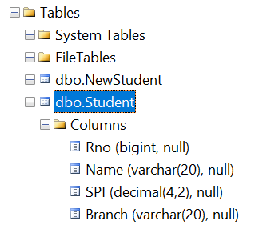
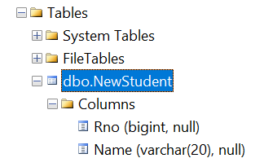
Select into
Basic SQL Commands
E.g. Create table NewStudent from Student with first two columns. (with DATA)
Create
Insert
SELECT
Rno,
Name
Select
INTO
NewStudent
Select into
FROM
Student
;
Update
Delete
Student
Rno | Name | SPI | Branch
101 | Raju | 9 | CE
102 | Sanjay | 6 | CE
103 | Neha | 8 | ME
NewStudent
Rno | Name
101 | Raju
102 | Sanjay
103 | Neha
Alter
Rename
Truncate
Drop
Note: Table schema and Data both will be copied.

Slide 41
Select into
Basic SQL Commands
E.g. Create table StudentClone from Student with all columns. (without DATA)
Create
Insert
SELECT
*
Select
INTO
StudentClone
Note:
Only Table schema will be copied not Data.
You just need to add one false condition.
So that it won't return any data and you will create clone copy of table without data.
Select into
FROM
Student
Update
WHERE
1=2
;
Delete
False Condition
Alter
StudentClone
Rno | Name | SPI | Branch
Rename
Limitations:
Indexes, constraints, and triggers defined in the source table are not transferred to the new table using SELECT into statement.
Truncate
Drop

Slide 42
Exercise: Select into
Create table Worldcup from cricket with all the columns and data.
Create table T20 from cricket with first two columns with data.
Create table IPL From Cricket with No Data.
Create table T20_Backup from cricket with all columns with no data.
Insert the Data into T20_Backup from Cricket Whose CITY is Mumbai.
Insert the Data into IPL From Cricket Whose age is greater then 32.
CRICKET
Name | City | Age
Sachin Tendulkar | Mumbai | 30
Rahul Dravid | Bombay | 35
M. S. Dhoni | Jharkhand | 31
Suresh Raina | Gujarat | 30

Slide 43
Update
Basic SQL Commands
The UPDATE statement is used to modify the existing records in a table.
Create
Syntax
Student
Rno | Name | SPI
101 | Anil | 9.28
102 | Mit | 10
103 | NULL | 7.15
Insert
UPDATE
TableName
Select
SET
Column1=value1
,
Column2=value2
,
Select into
….
WHERE
Condition
;
Update
Delete
E.g. Change the SPI to 5 of roll number 103
Student
Rno | Name | SPI
101 | Anil | 9.28
102 | Mit | 10
103 | NULL | 5
Alter
UPDATE
Student
Rename
SET
SPI=5
Truncate
WHERE
Rno=103
;
Drop

Slide 44
Update
Basic SQL Commands
The UPDATE statement is used to modify the existing records in a table.
Create
Syntax
Student
Rno | Name | SPI
101 | Anil | 9.28
102 | Mit | 10
103 | NULL | 7.15
Insert
UPDATE
TableName
Select
SET
Column1=value1
,
Column2=value2
,
Select into
….
WHERE
Condition
;
Update
NULL to Value
Delete
E.g. Change the name to Darshan where name is NULL
Student
Rno | Name | SPI
101 | Anil | 9.28
102 | Mit | 10
103 | Darshan | 5
Alter
UPDATE
Student
Rename
SET
Name='Darshan'
Truncate
WHERE
Name
IS NULL
;
Drop

Slide 45
Update
Basic SQL Commands
The UPDATE statement is used to modify the existing records in a table.
Create
Syntax
Student
Rno | Name | SPI
101 | Anil | 9.28
102 | Mit | 10
103 | NULL | 7.15
Insert
UPDATE
TableName
Select
SET
Column1=value1
,
Column2=value2
,
Select into
….
WHERE
Condition
;
Update
Value to NULL
Delete
E.g. Change the SPI of roll no 103 to NULL
Student
Rno | Name | SPI
101 | Anil | 9.28
102 | Mit | 10
103 | Darshan | NULL
Alter
UPDATE
Student
Rename
SET
SPI=NULL
Truncate
WHERE
Rno=103
;
Drop

Slide 46
Exercise: Update
Update branch Computer to CSE.
Update mobile number of Prof. Ankit Patel to 9999988888.
Update city Rajkot to Hadala.
Update branch Mechanical to ME.
Update mobile number of Prof. Bhavin Patel to NULL
Update ID of Prof. Ketan Akbari to NULL
Update ID to CSE_temp_01 whose ID is NULL (consider datatype of ID is varchar)
Set mobile number 99999 77777 where mobile number is not available.
Faculty
ID | Name | Mobile | City | Branch
258 | Prof. Ankit Patel | 8325845127 | Jetpur | Electrical
742 | Prof. Ketan Parmar | 9123141578 | Baroda | Computer
325 | Prof. Manan Doshi | 9223251578 | Gondal | Civil
125 | Prof. Mitesh Manek | 7878454512 | Rajkot | Computer
312 | Prof. Ketan Akbari | 9824485641 | Rajkot | Civil
457 | Prof. Bhavin Patel | 9825411111 | Jamnagar | Mechanical

Slide 47
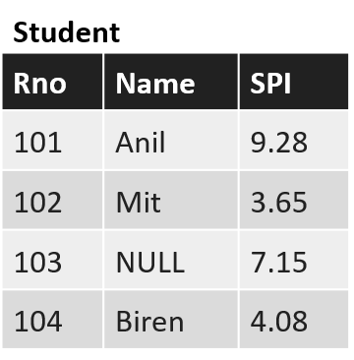
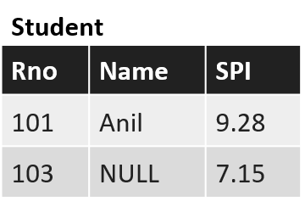
Delete
Basic SQL Commands
The DELETE statement is used to delete existing records in a table.
Create
Syntax
Insert
DELETE
Select
FROM
TableName
Select into
WHERE
Condition
;
Update
Delete
E.g. Delete all the students whose spi is below 5
Alter
DELETE
Rename
FROM
Student
Truncate
What happen if we Delete without condition?
WHERE
SPI<5
;
Drop
Note: * can not be used with Delete statement

Slide 48
Alter
Basic SQL Commands
ALTER TABLE statement is used to add, modify, or drop columns in a table.
The ALTER TABLE statement is also used to add and drop various constraints on an existing table.
Create
Insert
Select
Select into
Update
Delete
Alter
Rename
Truncate
Drop

Slide 49
Alter – Add Column
Basic SQL Commands
Syntax
Student
RNO | Name
101 | Raju
102 | Amit
103 | Sanjay
104 | Neha
105 | Meera
106 | Mahesh
Create
ALTER
TABLE
TableName
Insert
ADD
NewColumn1
Datatype(Size)
,
Select
NewColumn2
Datatype(Size)
;
Select into
Update
Example
Delete
ALTER
TABLE
Student
Student
RNO | Name | Branch | SPI
101 | Raju | NULL | NULL
102 | Amit | NULL | NULL
103 | Sanjay | NULL | NULL
104 | Neha | NULL | NULL
105 | Meera | NULL | NULL
106 | Mahesh | NULL | NULL
Alter
ADD
Branch
Varchar(20)
,
Rename
SPI
Decimal(4,2)
;
Truncate
Drop
Note: By default new added columns value will be NULL

Slide 50
Alter - Drop a column
Basic SQL Commands
Syntax
Create
ALTER
TABLE
TableName
Insert
DROP
COLUMN
ColumnName
;
Select
Select into
Student
RNO | Name | Branch | SPI
101 | Raju | NULL | NULL
102 | Amit | NULL | NULL
103 | Sanjay | NULL | NULL
104 | Neha | NULL | NULL
105 | Meera | NULL | NULL
106 | Mahesh | NULL | NULL
Student
RNO | Name
101 | Raju
102 | Amit
103 | Sanjay
104 | Neha
105 | Meera
106 | Mahesh
Update
ALTER
TABLE
Student
DROP
COLUMN
Branch
,
Delete
Alter
DROP
COLUMN
SPI
;
Rename
Truncate
Drop

Slide 51
Alter - Modify column
Basic SQL Commands
Used to change the data type of a column.
Create
Insert
Column1 | INT
Column2 | VARCHAR(20)
Column3
Select
Select into
VARCHAR(30)
DATETIME
Update
Syntax
Delete
ALTER
TABLE
TableName
Alter
ALTER
COLUMN
ColumnName
Datatype(Size)
;
Rename
Truncate
Drop

Slide 52
Alter
Basic SQL Commands
Impact: A new column is added to the table. Existing rows will have NULL values in this new column.
Impact: The specified column is removed from the table, and all data stored in that column is lost.
Impact: Changes the data type of the specified column. Data might be lost or truncated if the new type is incompatible or smaller than the old type.
What happen to existing data if we alter table??
Create
Insert
Select
Adding a Column
Select into
Update
Delete
Dropping a Column
Alter
Rename
Modifying a Column Type
Truncate
Drop

Slide 53
Exercise: Delete, Alter
Faculty
Delete whose id is less than 200.
Delete faculty from mechanical branch.
Delete faculty whose department is null.
Delete faculty who belongs to Jetpur or Gondal.
Delete all the records.
Add new column salary.
Add two more columns Qualification and Designation.
Change type of ID to varchar(10).
Change type of salary to int.
Drop column Qualification
Drop column City and Designation
ID | Name | Mobile | City | Branch
258 | Prof. Ankit Patel | 8325845127 | Jetpur | Electrical
742 | Prof. Ketan Parmar | 9123141578 | Baroda | Computer
325 | Prof. Manan Doshi | 9223251578 | Gondal | Civil
125 | Prof. Mitesh Manek | 7878454512 | Rajkot | Computer
312 | Prof. Ketan Akbari | 9824485641 | Rajkot | Civil
457 | Prof. Bhavin Patel | 9825411111 | Jamnagar | Mechanical

Slide 54
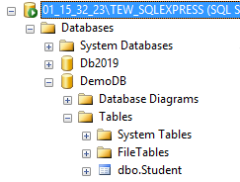
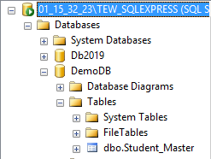

Rename
Basic SQL Commands
The SP_RENAME is used to change the name of a table or name of the column.
Create
Rename Table
Insert
Syntax
Select
SP_RENAME
OldTablename
,
NewTableName
;
Select into
Update
E.g.
Delete
SP_RENAME
‘Student’
,
‘Student_Master’
;
Alter
Rename
Truncate
Drop

Slide 55
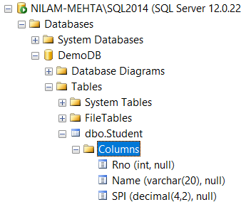
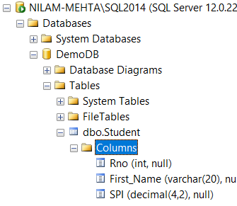
Rename
Basic SQL Commands
The SP_RENAME is used to change the name of a table or name of the column.
Create
Rename column
Insert
Syntax
Select
SP_RENAME
Tablename.ColumnName
,
NewColumnName
;
Select into
E.g.
Update
SP_RENAME
'Student.Name'
,
‘First_Name’
;
Delete
Alter
Rename
Truncate
Drop

Slide 56
Truncate
Basic SQL Commands
The TRUNCATE TABLE statement is used to delete all the rows from the table and free the space containing the table.
We cannot use Where clause with TRUNCATE.
The data will be deleted but the structure will remain in the memory for further operations.
Create
Insert
Select
Select into
Syntax
Update
TRUNCATE
TABLE
TableName
;
Delete
E.g.
Alter
TRUNCATE
TABLE
Student
;
Rename
Truncate
Drop

Slide 57
Drop
Basic SQL Commands
The SQL DROP command is used to remove an object from the database.
The DROP DATABASE statement is used to drop an existing SQL database.
Create
Drop Database
Insert
Select
Syntax
Select into
DROP
DATABASE
DatabseName
;
Update
E.g.
Delete
DROP
DATABASE
Student_Info
;
Alter
Rename
Truncate
Drop

Slide 58
Drop
Basic SQL Commands
The SQL DROP command is used to remove an object from the database.
The DROP TABLE statement is used to drop an existing table in a database.
If you drop a table, all the rows in the table is deleted and the table structure is removed from the database.
Once a table is dropped we cannot get it back.
Create
Drop Table
Insert
Select
Select into
Update
Syntax
Delete
DROP
TABLE
TableName
;
Alter
E.g.
Rename
DROP
TABLE
Student
;
Truncate
Drop

Slide 59
Exercise: Rename, Truncate, Drop
Faculty
Rename column name to Full_name.
Change column name ID to Faculty_ID
Change column name Branch to Department
Change table name to Faculty_Master
Delete all the data from table (Use: Truncate)
Drop faculty table.
Drop College Database.
ID | Name | Mobile | City | Branch
258 | Prof. Ankit Patel | 8325845127 | Jetpur | Electrical
742 | Prof. Ketan Parmar | 9123141578 | Baroda | Computer
325 | Prof. Manan Doshi | 9223251578 | Gondal | Civil
125 | Prof. Mitesh Manek | 7878454512 | Rajkot | Computer
312 | Prof. Ketan Akbari | 9824485641 | Rajkot | Civil
457 | Prof. Bhavin Patel | 9825411111 | Jamnagar | Mechanical

Slide 60
Delete v/s Truncate v/s Drop
Difference
Parameters | Drop | Delete | Truncate
Definition | It completely removes the table from the database | It removes one or more records from the table | It removes all the rows from the existing table
Type of Command | It is a DDL command | It is a DML command | It is a DDL command
Syntax | DROP TABLE table_name; | DELETE FROM tble_name WHERE conditions; | TRUNCATE TABLE table_name;
Memory Management | It completely removes the allocated space for the table from memory | It doesn’t free the allocated space of the table | It doesn’t free the allocated space of the table
Effect on Table | Removes the entire table structure | Doesn’t affect the table structure | Doesn’t affect the table structure
Speed and Performance | It is faster than DELETE but slower than TRUNCATE as it firstly deletes the rows and then the table from the database | It is slower than the DROP and TRUNCATE commands as it deletes one row at a time based on the specified conditions | It is faster than both the DELETE and DROP commands as it deletes all the records at a time without any condition

Slide 61
Why DBMS???
Constraints &
Keys
Database Concepts
Road Map
In-built functions
SQL Commands
Aggregate
functions
Datatypes
Operators

Slide 62
SQL Component

Slide 63
SQL Components
SQL Components
Data Definition Language(DDL)
Data Manipulation Language(DML)
Data Query Language(DQL)
Data Control Language(DCL)
Insert
Delete
Alter
Create
Update
Data Transaction Language(DTL)
Drop
Truncate
Select
Grant
Revoke
Commit
Rollback
Savepoint
Rename

Slide 64
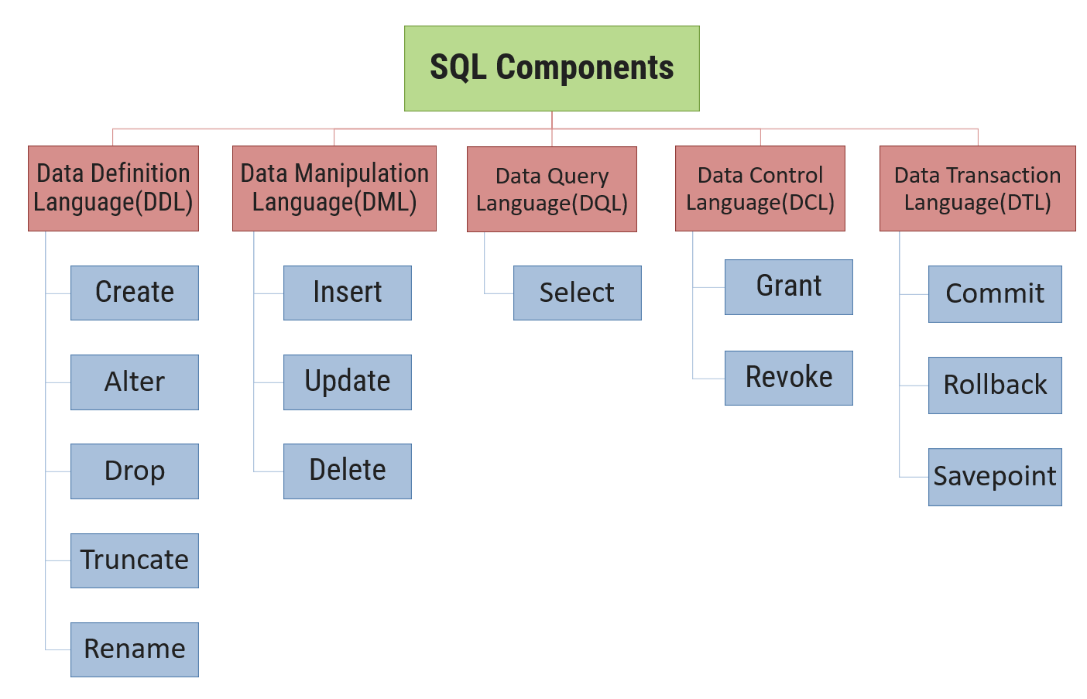
DDL (Data Definition Language)
DDL is a set of SQL commands used to create, modify, and delete database structures but not data.
Used by DBA and Database designer.
CREATE | To create tables in database
ALTER | To alter the schema or logical structure of the database
DROP | To delete the tables from the database
TRUNCATE | To remove all the records from the table
RENAME | To rename the column and table

Slide 65
DML (Data Manipulation Language)
A set of SQL commands to change the data of the table.
Used by general users who are accessing database by pre-developed application.
INSERT | To insert data in to table
UPDATE | To modify existing data in a table
DELETE | To delete records from the table

Slide 66
DQL (Data Query Language)
Allows data retrieval from the database.
SELECT | Allows data retrieval in different ways

Slide 67
DCL (Data Control Language)
Set of SQL commands used to control access to data and database.
DCL commands are grouped with DML commands.
GRANT | To give access privileges to users on the database
REVOKE | To withdraw access privileges given to users on the database

Slide 68
DTL (Data Transaction Language)
Managing the changes affecting the data.
COMMIT | To save work permanently
ROLLBACK | To undo work and restore database to previous state
SAVEPOINT | To identify a point in a transaction to which work can be undone

Slide 69
Basic SQL Operators

Slide 70
SQL AND, OR and NOT Operators
The WHERE clause can be combined with AND, OR, and NOT operators.
The AND & OR operators are used to filter records based on more than one condition.
The AND operator displays a record if all the conditions separated by AND are TRUE.
The OR operator displays a record if any of the conditions separated by OR is TRUE.
The NOT operator displays a record if the condition(s) is not TRUE.

Slide 71
AND Operator
Syntax:-
Student
Rno | Name | SPI | Branch
101 | Raju | 9 | CE
102 | Sanjay | 6 | CE
103 | Neha | 8 | ME
104 | Meera | 9 | EC
105 | Mahesh | 10 | EE
SELECT
*
FROM
TableName
WHERE
Condition
AND
Condition
;
E.g. Display all the students whose spi is more than 6 and less than 9
Output :
SELECT
*
Student
Rno | Name | SPI | Branch
103 | Neha | 8 | ME
FROM
Student
WHERE
SPI>6
AND
SPI<9
;

Slide 72
OR Operator
Syntax:-
Student
Rno | Name | SPI | Branch
101 | Raju | 9 | CE
102 | Sanjay | 6 | CE
103 | Neha | 8 | ME
104 | Meera | 9 | EC
105 | Mahesh | 10 | EE
SELECT
*
FROM
TableName
WHERE
Condition
OR
Condition
;
E.g. Display all the students whose are either from computer branch or from mechanical branch.
Output :
SELECT
*
Student
Rno | Name | SPI | Branch
101 | Raju | 9 | CE
102 | Sanjay | 6 | CE
103 | Neha | 8 | ME
FROM
Student
WHERE
Branch='CE'
OR
Branch='ME'
;

Slide 73
NOT Operator
Syntax:-
Student
Rno | Name | SPI | Branch
101 | Raju | 9 | CE
102 | Sanjay | 6 | CE
103 | Neha | 8 | ME
104 | Meera | 9 | EC
105 | Mahesh | 10 | EE
SELECT
*
FROM
TableName
WHERE
NOT
Condition
;
E.g. Display all the students who does not belongs to computer branch.
Output :
SELECT
*
Student
Rno | Name | SPI | Branch
103 | Neha | 8 | ME
104 | Meera | 9 | EC
105 | Mahesh | 10 | EE
FROM
Student
WHERE
NOT
Branch='CE'
;

Slide 74
SQL IN Operator
The IN operator allows you to specify multiple conditions in a WHERE clause.
IN operator is used to help reduce the need to use multiple "OR" conditions.
SQL NOT IN condition used to exclude the defined multiple value in a WHERE clause condition.
SQL NOT IN condition also identify by NOT operator.
Syntax:-
SELECT
Columns
FROM
TableName
WHERE
Columnname
IN
(
Value1,
Value2,
…
)
;

Slide 75
SQL IN Operator
E.g. Display all the students whose are either from computer branch or from mechanical branch.
Perform same query using OR operator
SELECT
*
SELECT
*
FROM
Student
FROM
Student
WHERE
Branch
IN
(
'CE'
,
'ME'
)
;
WHERE
Branch
=
'CE'
OR
Branch
=
'ME'
;
Student
Rno | Name | SPI | Branch
101 | Raju | 9 | CE
102 | Sanjay | 6 | CE
103 | Neha | 8 | ME
104 | Meera | 9 | EC
105 | Mahesh | 10 | EE
Output :
Student
Rno | Name | SPI | Branch
101 | Raju | 9 | CE
102 | Sanjay | 6 | CE
103 | Neha | 8 | ME
What is the difference between IN and OR ?
IN condition lists values in parenthesis, and it's better than working with multiple OR conditions

Slide 76
SQL Between Operator
The BETWEEN operator selects values within a given range.
SQL Between operator support only range type value like number, dates, character. But not supporting Boolean, string value range.
The BETWEEN operator is inclusive: begin and end values are included.
The NOT BETWEEN operator selects values which are not present in a given range.
Syntax:-
SELECT
Columns
FROM
TableName
WHERE
Columnname
BETWEEN
Value1
AND
Value2
;

Slide 77
SQL Between Operator
Between operator includes records with SPI 6 and 9.
E.g. Display all the students whose spi is more than 6 and less than 9
Perform same query using comparison operator
SELECT
*
SELECT
*
FROM
Student
FROM
Student
WHERE
SPI
BETWEEN
6
AND
9
;
WHERE
SPI
>=
6
AND
SPI
<=
9
;
Student
Rno | Name | SPI | Branch
101 | Raju | 9 | CE
102 | Sanjay | 6 | CE
103 | Neha | 8 | ME
104 | Meera | 9 | EC
105 | Mahesh | 10 | EE
Student
Rno | Name | SPI | Branch
101 | Raju | 9 | CE
102 | Sanjay | 6 | CE
103 | Neha | 8 | ME
104 | Meera | 9 | EC
Note: BETWEEN is a shorthand for the longer syntax
Use an alternative longer syntax where BETWEEN doesn't work because one or both of the values should not be included

Slide 78
Like Predicate

Slide 79
Like Predicate
The LIKE operator is used in a WHERE clause to search for a specified pattern in a column.
The LIKE keyword is used to select rows containing columns that match a wildcard pattern.
There are two wildcards:
Percent (%) : allows matching multiple character.
Underscore (_) : allows matching with any single character.

Slide 80
Like Predicate
Faculty | SrNo | Branch
 | 742 | Computer
 | 325 | Civil
 | 125 | Computer
 | 312 | Civil
Faculty
WHERE
BRANCH
LIKE
‘C%’
SELECT
SRNO,
BRANCH
FROM
;
CITY
Faculty
WHERE
CITY
LIKE
‘_a%’
Faculty | SrNo | City
 | 742 | Baroda
 | 125 | Rajkot
 | 312 | Rajkot
 | 457 | Jamnagar
SELECT
SRNO,
FROM
;
Faculty
SrNo | Name | Mobile | City | Branch
258 | Prof. Ankit Patel | 8325845127 | Jetpur | Electrical
742 | Prof. Ketan Parmar | 9123141578 | Baroda | Computer
325 | Prof. Manan Doshi | 9223251578 | Gondal | Civil
125 | Prof. Mitesh Manek | 7878454512 | Rajkot | Computer
312 | Prof. Ketan Akbari | 9824485641 | Rajkot | Civil
457 | Prof. Bhavin Patel | 9825411111 | Jamnagar | Mechanical

Slide 81
Exercise: LIKE Operator
Display names starts with ‘K’
Display names starts with ‘M’
Display branch ends with ‘L’
Display names ends with ‘ri’
Display cities contains ‘ro’
Display names contains ‘sh’
Display cities having length 6
Display cities having length 8 and starts with ‘J’
Display branch starts with ‘C’ and having 5 character
Display cities whose second character is ‘a’
Display cities whose second character is ‘o' AND last character is 'L'
Display branch starts with EITHER ‘C',’E', OR ‘M’
Display name starts with A to K
Display name whose second character is vowel
Display branch starts with ‘C’ and ends with ‘L’
Display cities not starts with ‘R’
Faculty
ID | Name | Mobile | City | Branch
258 | Ankit Patel | 8325845127 | Jetpur | Electrical
742 | Ketan Parmar | 9123141578 | Baroda | Computer
325 | Manan Doshi | 9223251578 | Gondal | Civil
125 | Mitesh Manek | 7878454512 | Rajkot | Computer
312 | Ketan Akbari | 9824485641 | Rajkot | Civil
457 | Bhavin Patel | 9825411111 | Jamnagar | Mechanical

Slide 82
Aggregate Functions

Slide 83
Aggregate function
An aggregate function in SQL performs a calculation on multiple values and returns a single scalar value.
SQL provides many aggregate functions like:
avg()
count()
sum()
min()
max()
An aggregate function ignores NULL values when it performs the calculation, except for the count function.
COUNT(column) ignores NULL values while counting, but COUNT(*) counts rows including NULL.
We often use aggregate functions with the GROUP BY and HAVING clauses of the SELECT statement.
Syntax : Aggregate Functions
aggregate_function ( DISTINCT | ALL expression)

Slide 84
Aggregate function
The following table shows the SQL Server aggregate functions:
Sr. | Aggregate function | Description
1 | AVG() | The AVG() aggregate function calculates the average of non-NULL values in a set.
2 | COUNT() | The COUNT() aggregate function returns the number of rows in a group. COUNT(column) ignores NULL values in counting, but COUNT(*) counts rows including NULL
3 | MAX() | The MAX() aggregate function returns the highest value (maximum) in a set of non-NULL values.
4 | MIN() | The MIN() aggregate function returns the lowest value (minimum) in a set of non-NULL values.
5 | SUM() | The SUM() aggregate function returns the summation of all non-NULL values a set.

Slide 85
Aggregate Functions Example
Student
Output
Example
Find out sum of CPI of all students.
Rno | Name | Branch | Semester | CPI
101 | Ramesh | CE | 3 | 9
102 | Mahesh | EC | 3 | 8
103 | Suresh | ME | 4 | 7
104 | Amit | EE | 4 | 8
105 | Anita | CE | 4 | 8
106 | Reeta | ME | 3 | 7
107 | Rohit | EE | 4 | 9
108 | Chetan | CE | 3 | 8
109 | Rakesh | CE | 4 | 9
Sum
73.00
Answer
Select SUM(CPI) AS [Sum] From Student
Example
Find out maximum & minimum CPI.
Output
Answer
Select MAX(CPI) AS [Max], MIN(CPI) AS [Min] From Student
Max | Min
9.00 | 7.00
Example
Count the number of students.
Output
Answer
Total
9
Select COUNT(RNo) AS [Total] From Student
Example
Find out average of CPI of all students.
Output
Answer
Select AVG(CPI) AS [Avg] From Student
Avg
8.111111

Slide 86
Exercise: Aggregate functions
Display highest salary.
Display lowest salary.
Display total salary.
Display average of salary.
Display total of all faculties salary.
Count total record in the table.
Count total ID.
Display highest salary from Computer department.
Display minimum salary from civil department.
Display average salary from Rajkot city.
Display maximum, minimum, average and total salary.
Display all the faculties whose salary is less then average salary.
Faculty
ID | Name | Salary | City | Branch
258 | Ankit Patel | 50000 | Jetpur | Electrical
742 | Ketan Parmar | 75000 | Baroda | Computer
325 | Manan Doshi | 65000 | Gondal | Civil
125 | Mitesh Manek | 55000 | Rajkot | Computer
312 | Ketan Akbari | 28000 | Rajkot | Civil
Null | Bhavin Patel | 35000 | Jamnagar | Mechanical

Slide 87
Group By and Having Clause

Slide 88





Group by
COMPUTER ENGINEER
CIVIL
ENGINEER
GROUP OF ENGINEERS
ELECTRIC ENGINEER
MECHANICAL ENGINEER

Slide 89
What is Group by?
It creates a group of distinct values from available records.
It groups records based on the distinct values for specified columns.
Syntax:-
SELECT
COLUMN1,
COLUMN2,
AGGREGATE FUNCTION (COLUMN)
FROM
NAME OF TABLE
GROUP BY
COLUMN1,
COLUMN2,
…COLUMNn
;

Slide 90
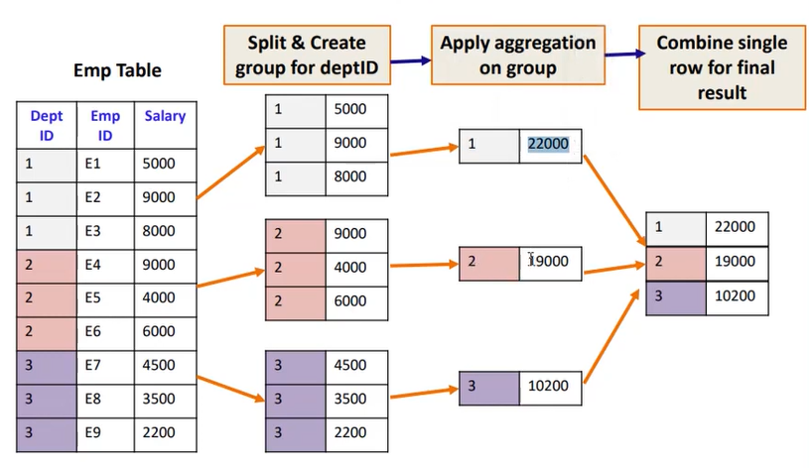
How grouping works?

Slide 91
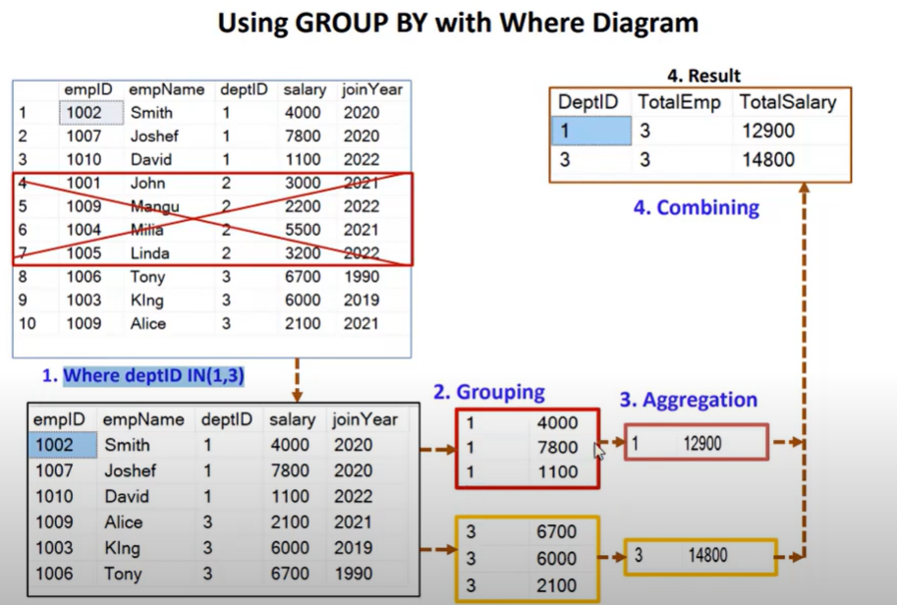

Slide 92
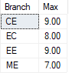
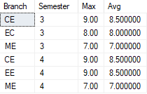
Aggregate Functions with Group By Example
Student
Example
Find out Branch wise Maximum CPI.
Rno | Name | Branch | Semester | CPI
101 | Ramesh | CE | 3 | 9
102 | Mahesh | EC | 3 | 8
103 | Suresh | ME | 4 | 7
104 | Amit | EE | 4 | 8
105 | Anita | CE | 4 | 8
106 | Reeta | ME | 3 | 7
107 | Rohit | EE | 4 | 9
108 | Chetan | CE | 3 | 8
109 | Rakesh | CE | 4 | 9
Answer
Select Branch, MAX(CPI) AS [Max] From Student Group By Branch
Output
Example
Find out Branch wise Semester wise Minimum & Average CPI.
Answer
Select Branch, Semester, MAX(CPI) AS [Max], MIN(CPI) AS [Min] From Student Group By Branch, Semester
Output

Slide 93

Having Clause
COMPUTER ENGINEER
GROUP OF ENGINEERS
PROGRAMMER

Slide 94
Having Clause
Group By creates a group of distinct values from available records and to put filter on those records you have to use having clause.
It must appear within an aggregate function.
Syntax:
SELECT
COLUMN1,
COLUMN2,
AGGREGATE FUNCTION (COLUMN)
FROM
NAME OF TABLE
GROUP BY
COLUMN1,
COLUMN2,
…COLUMNn
HAVING
CONDITION
;

Slide 95
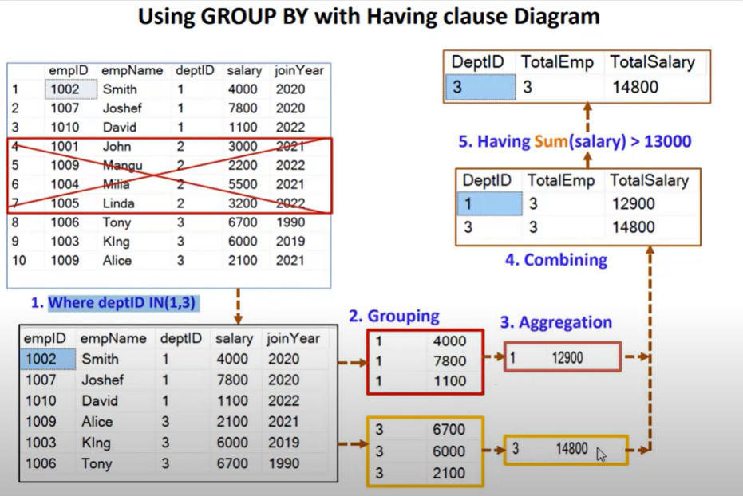

Slide 96
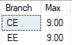
Aggregate Functions Group By with Having
Student
Rno | Name | Branch | Semester | CPI
101 | Ramesh | CE | 3 | 9
102 | Mahesh | EC | 3 | 8
103 | Suresh | ME | 4 | 7
104 | Amit | EE | 4 | 8
105 | Anita | CE | 4 | 8
106 | Reeta | ME | 3 | 7
107 | Rohit | EE | 4 | 9
108 | Chetan | CE | 3 | 8
109 | Rakesh | CE | 4 | 9
Example
Find out All the Branches with maximum CPI, whose maximum CPI is more than 8.
Answer
Select Branch, MAX(CPI) AS [Max] From Student Group By Branch Having MAX(CPI) > 8
Output

Slide 97
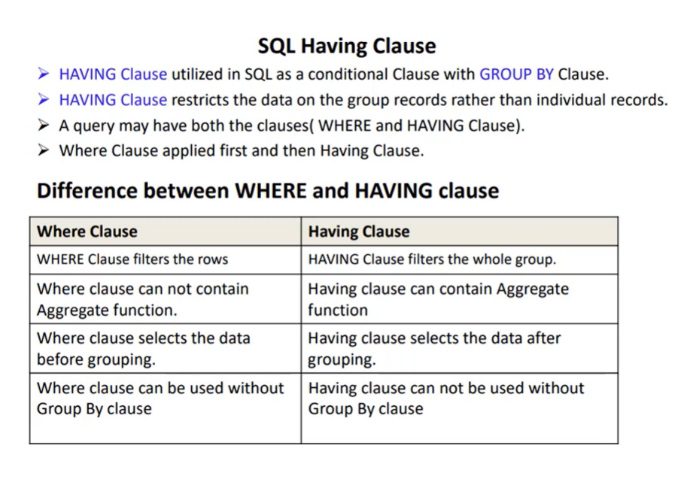

Slide 98





Order by
To show data in sorted order (ascending order or descending order)
Rows are sorted based on column specified with ORDER BY
By default rows are sort in ascending order
To sort rows in descending order we have to write DESC

Slide 99
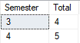
Aggregate Functions Group By with Order by
Student
Rno | Name | Branch | Semester | CPI
101 | Ramesh | CE | 3 | 9
102 | Mahesh | EC | 3 | 8
103 | Suresh | ME | 4 | 7
104 | Amit | EE | 4 | 8
105 | Anita | CE | 4 | 8
106 | Reeta | ME | 3 | 7
107 | Rohit | EE | 4 | 9
108 | Chetan | CE | 3 | 8
109 | Rakesh | CE | 4 | 9
Example
Find out semester wise total students & arrange them in order with their count.
Answer
Select Semester, Count(Rno) AS [Total] From Student Group By Semester Order By Total
Output

Slide 100
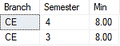
Aggregate Functions Group By with Having & Order by
Student
Rno | Name | Branch | Semester | CPI
101 | Ramesh | CE | 3 | 9
102 | Mahesh | EC | 3 | 8
103 | Suresh | ME | 4 | 7
104 | Amit | EE | 4 | 8
105 | Anita | CE | 4 | 8
106 | Reeta | ME | 3 | 7
107 | Rohit | EE | 4 | 9
108 | Chetan | CE | 3 | 8
109 | Rakesh | CE | 4 | 9
Example
Find out Branch wise & Semester wise minimum CPI details of CE branch’s students in which minimum CPI is greater than 7. Do arrange the result in descending order to semester.
Answer
Select Branch, Semester, MIN(CPI) AS [Min] From Student Where Branch='CE' Group By Branch, Semester Having MIN(CPI) > 7 Order By Semester Desc
Output

Slide 101
Exercise – Group by, Order by
Faculty
Find branch wise highest salary.
Find city wise lowest salary.
Find branch wise highest, lowest and average salary.
Find average salary of Computer branch.
Find branch wise highest salary, where highest salary is more then 50000.
Find city wise, branch wise total salary.
Find city wise average salary and display then in ascending order.
Display branch wise maximum salary in descending order.
Find branch wise total faculties in descending order.
Find out branch wise & city wise total salary of computer branch with total salary is greater than 50000.do arrange the result in descending order to total salary.
ID | Name | Salary | City | Branch
258 | Ankit Patel | 50000 | Jetpur | Electrical
742 | Ketan Parmar | 75000 | Baroda | Computer
325 | Manan Doshi | 65000 | Gondal | Civil
125 | Mitesh Manek | 55000 | Rajkot | Computer
312 | Ketan Akbari | 28000 | Rajkot | Civil
Null | Bhavin Patel | 35000 | Jamnagar | Mechanical

Slide 102
SQL in-built Functions

Slide 103
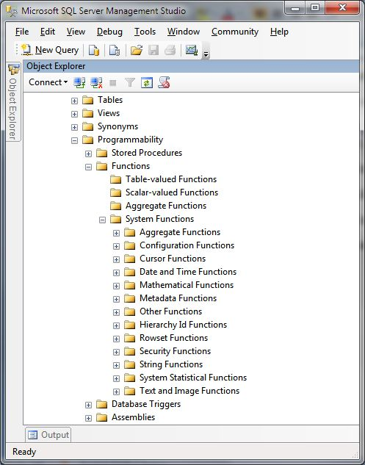
SQL in-built Functions
Built-in or System functions are available with every database, we can use it as per our requirement.
Sr. | System Functions
1 | Aggregate Functions
2 | Date and Time Functions
3 | Mathematical Functions
4 | String Functions
5 | Other Functions

Slide 104
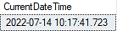
Date & Time Functions
SQL Server comes with the following data types for storing a date or a date/time value in the database:
DATE– format YYYY-MM-DD
DATETIME – format YYYY-MM-DD HH:MI:SS
SMALLDATETIME – format: YYYY-MM-DD HH:MI:SS
TIMESTAMP – format: a unique identifier
To retrieve current date time, we can use GETDATE():
Current Date & Time
Output
Select GETDATE() AS CurrentDateTime

Slide 105
Date & Time Functions
List of SQL DATE Functions
Date Functions | Description | Return Value Data Type
DAY (date or datetime) | Returns the day of the week for a given date | Integer like 1 - 31
MONTH (date or datetime) | Returns the month of a given date | Integer like 1 - 12
YEAR (date or datetime) | Returns the year of a given date | Integer for year like 2021
DATEPART (date part, date or datetime) | Returns the date part specified in int format | Integer like 1 – 12 for month, 1 – 31 for day, or year like 2021
DATENAME (date part, date or datetime) | Returns the date part specified in character format | Character like April, May, ‘1’, ‘2’, ‘31’, ‘2020’, ‘2021’
EOMONTH (date [,months to add) | Returns the last do of the month with an optional parameter to add months (+ or -). | Returns end date of specified date
DATEADD (date part, units, date or datetime) | Return date math results | datetime
DATEDIFF (date part, start date, end date) | Give the difference between 2 dates in units specified by date part | Integer of date part units
ISDATE (potential date string) | Use to validate a date string | Returns 1 if the string is a valid date or 0 if not a valid date.

Slide 106
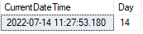
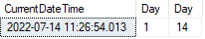
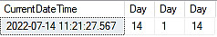
Date & Time Functions | DAY()
DAY() : The date function DAY accepts a date, datetime, or valid date string and returns the Day part as an
integer value.
Example - 1
Output
SELECT GETDATE() AS CurrentDateTime, DAY(GETDATE()) AS [Day]
Example - 2
Output
SELECT GETDATE() AS CurrentDateTime, DAY('20220101') AS [Day], DAY('2022-07-14 15:46:19.277') AS [Day]
Example - 3
Output
SELECT GETDATE() AS CurrentDateTime, DAY(GETDATE()) AS [Day] , DAY('20220101') AS [Day], DAY('2022-07-14 15:46:19.277') AS [Day]

Slide 107
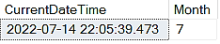
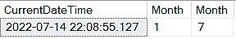
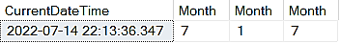
Date & Time Functions | MONTH ()
MONTH() : The date function MONTH accepts a date, datetime, or valid date string and returns the Month part as an integer value.
Example - 1
Output
SELECT GETDATE() AS CurrentDateTime, MONTH(GETDATE()) AS [Month]
Example - 2
Output
SELECT GETDATE() AS CurrentDateTime, MONTH('20220101') AS [Month], MONTH('2022-07-14 15:46:19.277') AS [Month]
Example - 3
Output
SELECT GETDATE() AS CurrentDateTime, MONTH(GETDATE()) AS [Month] , MONTH('20220101') AS [Month], MONTH('2022-07-14 15:46:19.277') AS [Month]

Slide 108
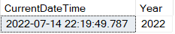
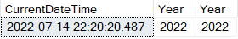
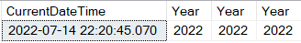
Date & Time Functions | YEAR ()
YEAR() : The date function YEAR accepts a date, datetime, or valid date string and returns the Year part as an integer value.
Example - 1
Output
SELECT GETDATE() AS CurrentDateTime, YEAR(GETDATE()) AS [Year]
Example - 2
Output
SELECT GETDATE() AS CurrentDateTime, YEAR('20220101') AS [Year], YEAR('2022-07-14 15:46:19.277') AS [Year]
Example - 3
Output
SELECT GETDATE() AS CurrentDateTime, YEAR(GETDATE()) AS [Year] , YEAR('20220101') AS [Year], YEAR('2022-07-14 15:46:19.277') AS [Year]

Slide 109
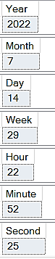
Date & Time Functions | DATEPART ()
DATEPART() : It returns an integer corresponding to the datepart specified in DATEPART function.
Example
Output
SELECT DATEPART(YEAR, GETDATE()) AS 'Year';
SELECT DATEPART(MONTH, GETDATE()) AS 'Month';
SELECT DATEPART(DAY, GETDATE()) AS 'Day';
SELECT DATEPART(WEEK, GETDATE()) AS 'Week';
SELECT DATEPART(HOUR, GETDATE()) AS 'Hour';
SELECT DATEPART(MINUTE, GETDATE()) AS 'Minute';
SELECT DATEPART(SECOND, GETDATE()) AS 'Second';

Slide 110
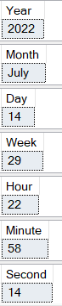
Date & Time Functions | DATENAME ()
DATENAME() : It returns a string corresponding to the datepart specified for the given date
Example
Output
SELECT DATENAME(YEAR, GETDATE()) AS 'Year';
SELECT DATENAME(MONTH, GETDATE()) AS 'Month';
SELECT DATENAME(DAY, GETDATE()) AS 'Day';
SELECT DATENAME(WEEK, GETDATE()) AS 'Week';
SELECT DATENAME(HOUR, GETDATE()) AS 'Hour';
SELECT DATENAME(MINUTE, GETDATE()) AS 'Minute';
SELECT DATENAME(SECOND, GETDATE()) AS 'Second';

Slide 111
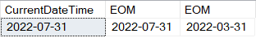
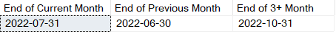
Date & Time Functions | EOMONTH ()
EOMONTH() :
The date function EOMONTH accepts a date, datetime, or valid date string and returns the end of month date as a datetime.
It can also take an optional offset that basically adds or subtracts months from the current passed date.
Example - 1
Output
SELECT EOMONTH(GETDATE()) AS CurrentDateTime, EOMONTH('20220701') AS EOM, EOMONTH('March 1, 2022') AS EOM
Example - 2
Output
SELECT
EOMONTH(GETDATE()) as 'End Of Current Month',
EOMONTH(GETDATE(),-1) as 'End Of Previous Month',
EOMONTH(GETDATE(),3) as 'End Of 6+ Month';

Slide 112
Date & Time Functions | DATEADD ()
DATEADD() : It returns datepart with added interval as a datetime.
Example
Datepart | Query | Output
DateGroup : Day
d | SELECT DATEADD(d, 1, '2022-07-14 15:15:20') AS ADDEDDATE | 2022-07-15 15:15:20.000
dd | SELECT DATEADD(dd, 1, '2022-07-14 15:15:20') AS ADDEDDATE | 2022-07-15 15:15:20.000
day | SELECT DATEADD(day, 1, '2022-07-14 15:15:20') AS ADDEDDATE | 2022-07-15 15:15:20.000
DateGroup : Month
m | SELECT DATEADD(m, 1, '2022-07-14 15:15:20') AS ADDEDMONTH | 2022-08-14 15:15:20.000
mm | SELECT DATEADD(mm, 1, '2022-07-14 15:15:20') AS ADDEDMONTH | 2022-08-14 15:15:20.000
month | SELECT DATEADD(month, 1, '2022-07-14 15:15:20') AS ADDEDMONTH | 2022-08-14 15:15:20.000
DateGroup : Year
yy | SELECT DATEADD(yy, 1, '2022-07-14 15:15:20') AS ADDEDYEAR | 2023-07-14 15:15:20.000
yyyy | SELECT DATEADD(yyyy, 1, '2022-07-14 15:15:20') AS ADDEDYEAR | 2023-07-14 15:15:20.000
year | SELECT DATEADD(year, 1, '2022-07-14 15:15:20') AS ADDEDYEAR | 2023-07-14 15:15:20.000

Slide 113
Date & Time Functions | DATEDIFF ()
DATEDIFF() :
It gets the difference between two dates with the results returned in date units specified as years, months days, minutes, seconds as an integer value.
Example
DiffPart | Query | Output
Minutes | SELECT DATEDIFF(MINUTE, '2022-07-13', '2022-07-14') | 1440
Hours | SELECT DATEDIFF(HOUR, '2022-07-13', '2022-07-14') | 24
Days | SELECT DATEDIFF(DAY, '2022-07-01', '2022-07-14') | 13
Months | SELECT DATEDIFF(MONTH, '2022-07-01', '2022-08-14') | 1
Years | SELECT DATEDIFF(YEAR, '2022-07-01', '2025-08-14') | 3

Slide 114
Date & Time Functions | ISDATE ()
ISDATE() :
To check a string to see if it is a valid Date or Datetime field.
ISDATE return 1 if true or 0 if false.
Example
Query | Output
SELECT ISDATE('20220101') as 'Valid'; | 1
SELECT ISDATE('01/01/22') as 'Valid'; | 1
SELECT ISDATE('13/01/2022') as 'Not Valid'; | 0
SELECT ISDATE('2022') as 'Valid'; | 1
SELECT ISDATE('2022-13-01') as 'Not Valid'; | 0

Slide 115
Mathematical Functions
SQL Server Math/Numeric Functions
Example
Function Name | Description | Output
ABS() | Returns the absolute value of a number SELECT ABS(20), ABS(-50) | 20, 50
CEILING() | Returns the smallest integer value that is >= a number SELECT CEILING(-13.5), CEILING(25) | -13, 25
FLOOR() | Returns the largest integer value that is <= to a number SELECT FLOOR(-13.5), FLOOR(25.75) | -14, 25
PI() | Returns the value of PI SELECT PI() | 3.14159265358979
POWER() | Returns the value of a number raised to the power of another number SELECT POWER(4, 2) | 16

Slide 116
Mathematical Functions (Cont..)
SQL Server Math/Numeric Functions
Example
Function Name | Description | Output
ROUND() | Rounds a number to a specified number of decimal places SELECT ROUND(235.415, 0),ROUND(235.415, 1),ROUND(235.415, 2) | 235.000 235.400 235.420
SIGN() | Returns the sign of a number (If number > 0, it returns 1, If number = 0, it returns 0, If number < 0, it returns -1) SELECT SIGN(-12), SIGN(12), SIGN(0) | -1 1 0
SQRT() | Returns the square root of a number SELECT SQRT(64) | 8
SQUARE() | Returns the square of a number SELECT SQUARE(8) | 64

Slide 117
String Functions
String Functions
Function Name | Description | Output
ASCII() | The ASCII() function accepts a character expression and returns the ASCII code value of the leftmost character of the character expression. SELECT ASCII('A'), ASCII('a') | 65, 97
CONCAT() | To join two or more strings into one, you use the CONCAT() function, The CONCAT() takes two up to 255 input strings and joins them into one. It requires at least two input strings. If you pass one input string, the CONCAT() function will raise an error. If you pass non-character string values, the CONCAT() function will implicitly convert those values into strings before concatenating. The CONCAT() function also converts NULL into an empty string with the type VARCHAR(1). SELECT CONCAT('Darshan',' ','University') | Darshan University
CONCAT_WS() | CONCAT_WS() is very similar to CONCAT() function, but it allows the user to specify a separator between the concatenated input strings. It can be used to generate comma-separated values. SELECT CONCAT_WS(',','Darshan','University') | Darshan,University

Slide 118
String Functions
String Functions
Function Name | Description | Output
CHARINDEX() | CHARINDEX() is a scalar SQL string function used to return the index of a specific string expression within a given string. CHARINDEX() has 2 required parameters which are the input string and character and one optional parameter which is the starting index of the search operation (If this argument is not specified or is less or equal than zero (0) value, the search starts at the beginning of input string). SELECT CHARINDEX('t', 'Customer’), CHARINDEX('World','Hello World') | 4, 7
LEFT(), RIGHT() | LEFT() and RIGHT() functions are one of the most popular SQL string functions. They are used to extract a specific number of characters from the left-side or right-side of a string. SELECT LEFT('Darshan University',5) , RIGHT('Darshan University',5) | Darsh, rsity

Slide 119
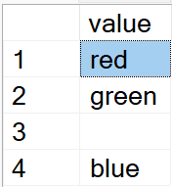
String Functions
String Functions
Function Name | Description | Output
LOWER(), UPPER() | LOWER() is used to change the letter case to a lower case. UPPER() is used to change the case of the letters into upper case. Select LOWER('Darshan'), UPPER('Darshan') | darshan DARSHAN
LTRIM(), RTRIM() | LTRIM() and RTRIM() function are used to remove additional spaces from the left side or right side of an input string. SELECT RTRIM('Darshan ') + LTRIM(' University') | DarshanUniversity
STRING_SPLIT() | It is a table-valued function that splits a string into a table that consists of rows of substrings based on a specified separator. Syntax: STRING_SPLIT ( input_string , separator ) It returns a single-column table, whose column name is value. SELECT value FROM STRING_SPLIT('red,green,,blue', ',')

Slide 120
String Functions
String Functions
Function Name | Description | Output
REPLACE() | To replace all occurrences of a substring within a string with a new substring. Syntax: REPLACE(input_string, substring, new_substring); SELECT REPLACE('Darshan Institute','Institute','University') | Darshan University
REPLICATE() | It repeats a string a specified number of times. SELECT REPLICATE('Darshan',2) | DarshanDarshan
REVERSE() | It accepts a string argument and returns the reverse order of that string. SELECT REVERSE('Darshan') | nahsraD
SPACE() | It returns a string of repeated spaces. SELECT SPACE(5)+ 'Darshan' | Darshan

Slide 121
String Functions
String Functions
Function Name | Description | Output
SUBSTRING() | It extracts a substring with a specified length starting from a location in an input string. Syntax: SUBSTRING(input_string, Start, Length); Start is an integer that specifies the location where the returned substring starts. Note that the first character in the input_string is 1, not zero. Length is a positive integer that specifies the number of characters of the substring to be returned. The SUBSTRING() function raises an error if the length is negative. If start + length > the length of input_string, the substring will begin at the start and include the remaining characters of the input_string. SELECT SUBSTRING('SQL Server SUBSTRING', 5, 6) | Server
LEN() | The LEN function is used to provide the number of characters in a string without including trailing spaces. Select LEN('Darshan University') | 18

Slide 122
Other Functions
Other Functions
Function Name | Description | Output
CAST() | It converts a value (of any type) into a specified datatype. Syntax: CAST(expression AS datatype(length)) SELECT CAST(25.65 AS varchar) | 25.65
CONVERT() | It converts a value (of any type) into a specified datatype. Syntax: CONVERT(data_type(length), expression, style) SELECT CONVERT(varchar,25.65) Style is optional, The format used to convert between data types, such as a date or string format. SELECT CONVERT(varchar(20), getdate(), 100) | 25.65 ---------------- Jul 14 2022 10:59AM

Slide 123
Keys

Slide 124
What is Key?
Key is a attribute or a set of attribute that uniquely identify each record of a table.
It is also used to find or create the relation between two or more tables.
Faculty
ID | Name | Salary | City | Branch
258 | Ankit Patel | 50000 | Jetpur | Electrical
742 | Ketan Parmar | 75000 | Baroda | Computer
329 | Ankit Patel | 50000 | Jetpur | Electrical
125 | Mitesh Manek | 55000 | Rajkot | Computer
312 | Ketan Akbari | 28000 | Rajkot | Civil
459 | Ankit Patel | 50000 | Jetpur | Electrical

Slide 125

Types of Keys
Super
Key
Foreign Key
Candidate
Key
Composite Key
Primary
Key
Unique
key
Alternate
Key

Slide 126
Super Key
A super key is a set of one or more attributes that allow us to identify each tuple uniquely in a relation.
Super Key
Emp_ID
Not Super Key
Emp_Name
Super Key
Emp_EmailID
Super Key
Emp_SSN
Employee | Emp_SSN | EmpID | Emp_Name | Emp_EmailID
 | 115121 | 101 | Mahesh | mahesh@gmail.com
 | 854121 | 102 | Rakesh | rakesh@gmail.com
 | 321412 | 103 | Mukesh | mukesh@gmail.com
 | 854113 | 104 | Kirit | kirit@gmail.com
 | 513142 | 105 | Pritesh | pritesh@gmail.com
 | 251438 | 106 | Priti | priti@gmail.com
 | 327812 | 107 | Hitesh | hitesh@gmail.com
Super Key
Emp_SSN, Emp_ID
Super Key
Emp_ID, Emp_Name

Slide 127
Super Key
A super key is a set of one or more attributes that allow us to identify each tuple uniquely in a relation.
Super Key
Emp_SSN, Emp_Name, Emp_ID
Super Key
Emp_SSN, Emp_ID, Emp_EmailID
Employee | Emp_SSN | EmpID | Emp_Name
 | 115121 | 101 | Mahesh
 | 854121 | 102 | Rakesh
 | 321412 | 103 | Mukesh
 | 854113 | 104 | Kirit
 | 513142 | 105 | Pritesh
 | 251438 | 106 | Priti
 | 327812 | 107 | Hitesh
Employee | Emp_SSN | EmpID | Emp_EmailID
 | 115121 | 101 | mahesh@gmail.com
 | 854121 | 102 | rakesh@gmail.com
 | 321412 | 103 | mukesh@gmail.com
 | 854113 | 104 | kirit@gmail.com
 | 513142 | 105 | pritesh@gmail.com
 | 251438 | 106 | priti@gmail.com
 | 327812 | 107 | hitesh@gmail.com

Slide 128
Exercise: Super Key
Super keys
Enrollment no
Aadhar no
{Enrollment no, name}
{Enrollment no, Aadhar no}
{Enrollment no, phone}
{Enrollment no, email}
{phone}
{name, phone, Aadhar no}
{Enrollment no, Aadhar no, phone}
…….
Student
Enrollment no | Name | Aadhar No | Sem | Phone | Email
25010101003 | Ramesh | 12346546 | 3 | 636262652 | Ramesh@gmail.com
22010101954 | Mahesh | 54464454 | 3 | 936262653 | Mahesh@gmail.com
23010101457 | Suresh | 27357257 | 4 | 946262679 | Suresh@gmail.com
21010101756 | Amit | 73273732 | 4 | 453178921 | Amit@gmail.com
22010101473 | Anita | 14245477 | 4 | 123456457 | Anita@gmail.com
23010101464 | Reeta | 32124454 | 3 | 897421456 | Reeta@gmail.com
25010101024 | Rohit | 56446879 | 4 | 654548778 | Rohit@gmail.com
20010101454 | Chetan | 31255456 | 3 | 258698472 | Chetan@gmail.com
22010101793 | Rakesh | 45217912 | 4 | 598736524 | Rakesh@gmail.com

Slide 129
Candidate Key
Minimal super key is called Candidate key.
A candidate key is a subset of a super key.
A candidate key is the least combination of attribute that uniquely identifies each record in the table.
Every candidate key is a super key but every super key is not a candidate key.
Candidate Key
Emp_SSN
Employee | Emp_SSN | EmpID | Emp_Name | Emp_EmailID
 | 115121 | 101 | Mahesh | mahesh@gmail.com
 | 854121 | 102 | Rakesh | rakesh@gmail.com
 | 321412 | 103 | Mukesh | mukesh@gmail.com
 | 854113 | 104 | Kirit | kirit@gmail.com
 | 513142 | 105 | Pritesh | pritesh@gmail.com
 | 251438 | 106 | Priti | priti@gmail.com
 | 327812 | 107 | Hitesh | hitesh@gmail.com
Candidate Key
Emp_EmailID
Candidate Key
Emp_ID

Slide 130
Exercise: Candidate Key
Super keys
Enrollment no
Aadhar no
{Enrollment no, name}
{Enrollment no, Aadhar no}
{Enrollment no, phone}
{Enrollment no, email}
Phone
Email
{name, phone, Aadhar no}
{Enrollment no, Aadhar no, phone}
…….
Candidate keys
Enrollment no
Aadhar no
Phone
Email
Student
Enrollment no | Name | Aadhar No | Sem | Phone | Email
25010101003 | Ramesh | 12346546 | 3 | 636262652 | Ramesh@gmail.com
22010101954 | Mahesh | 54464454 | 3 | 936262653 | Mahesh@gmail.com
23010101457 | Suresh | 27357257 | 4 | 946262679 | Suresh@gmail.com
21010101756 | Amit | 73273732 | 4 | 453178921 | Amit@gmail.com
22010101473 | Anita | 14245477 | 4 | 123456457 | Anita@gmail.com
23010101464 | Reeta | 32124454 | 3 | 897421456 | Reeta@gmail.com
25010101024 | Rohit | 56446879 | 4 | 654548778 | Rohit@gmail.com
20010101454 | Chetan | 31255456 | 3 | 258698472 | Chetan@gmail.com
22010101793 | Rakesh | 45217912 | 4 | 598736524 | Rakesh@gmail.com

Slide 131

Primary Key
A Primary key is a candidate key that is chosen by database designer to identify tuples uniquely in a relation.
Primary Key
Unique + Not Null
Candidate Key
Emp_SSN
Candidate Key
Emp_EmailID
Employee | Emp_SSN | EmpID | Emp_Name | Emp_EmailID
 | 115121 | 101 | Mahesh | mahesh@gmail.com
 | 854121 | 102 | Rakesh | rakesh@gmail.com
 | 321412 | 103 | Mukesh | mukesh@gmail.com
 | 854113 | 104 | Kirit | kirit@gmail.com
 | 513142 | 105 | Pritesh | pritesh@gmail.com
 | 251438 | 106 | Priti | priti@gmail.com
 | 327812 | 107 | Hitesh | hitesh@gmail.com
Can we make
Emp_EmailID
As Primary key?
Candidate Key
Emp_ID

Slide 132
Primary Key rules
A primary key may have one or more attributes.
There is only one primary key in the relation (table).
A primary key attribute value cannot be NULL.
Generally, the value of a primary key attribute does not change or very rarely change.
Primary key = unique + not null

Slide 133
Exercise: Primary Key
Candidate keys
Enrollment no
Aadhar no
Phone
Email
Primary key
Enrollment no
Student
Enrollment no | Name | Aadhar No | Sem | Phone | Email
25010101003 | Ramesh | 12346546 | 3 | 636262652 | Ramesh@gmail.com
22010101954 | Mahesh | 54464454 | 3 | 936262653 | Mahesh@gmail.com
23010101457 | Suresh | 27357257 | 4 | 946262679 | Suresh@gmail.com
21010101756 | Amit | 73273732 | 4 | 453178921 | Amit@gmail.com
22010101473 | Anita | 14245477 | 4 | 123456457 | Anita@gmail.com
23010101464 | Reeta | 32124454 | 3 | 897421456 | Reeta@gmail.com
25010101024 | Rohit | 56446879 | 4 | 654548778 | Rohit@gmail.com
20010101454 | Chetan | 31255456 | 3 | 258698472 | Chetan@gmail.com
22010101793 | Rakesh | 45217912 | 4 | 598736524 | Rakesh@gmail.com

Slide 134
Alternate Key
If any table have more than one candidate key, then after choosing primary key from those candidate key, rest of candidate keys are known as an alternate key of that table.
Primary Key
Candidate Key
Emp_SSN
Candidate Key
Emp_EmailID
Employee | Emp_SSN | EmpID | Emp_Name | Emp_EmailID
 | 115121 | 101 | Mahesh | mahesh@gmail.com
 | 854121 | 102 | Rakesh | rakesh@gmail.com
 | 321412 | 103 | Mukesh | mukesh@gmail.com
 | 854113 | 104 | Kirit | kirit@gmail.com
 | 513142 | 105 | Pritesh | pritesh@gmail.com
 | 251438 | 106 | Priti | priti@gmail.com
 | 327812 | 107 | Hitesh | hitesh@gmail.com
Alternate Key
Alternate Key
Candidate Key
Emp_ID

Slide 135
Exercise: Alternate Key
Candidate keys
Enrollment no
Aadhar no
Phone
Email
Primary key
Enrollment no
Alternate key
Aadhar no
Phone
Email
Student
Enrollment no | Name | Aadhar No | Sem | Phone | Email
25010101003 | Ramesh | 12346546 | 3 | 636262652 | Ramesh@gmail.com
22010101954 | Mahesh | 54464454 | 3 | 936262653 | Mahesh@gmail.com
23010101457 | Suresh | 27357257 | 4 | 946262679 | Suresh@gmail.com
21010101756 | Amit | 73273732 | 4 | 453178921 | Amit@gmail.com
22010101473 | Anita | 14245477 | 4 | 123456457 | Anita@gmail.com
23010101464 | Reeta | 32124454 | 3 | 897421456 | Reeta@gmail.com
25010101024 | Rohit | 56446879 | 4 | 654548778 | Rohit@gmail.com
20010101454 | Chetan | 31255456 | 3 | 258698472 | Chetan@gmail.com
22010101793 | Rakesh | 45217912 | 4 | 598736524 | Rakesh@gmail.com

Slide 136
Unique Key
It uniquely identify the tuple but it may contain NULL value.
NULL is also allowed only once.
Unique Key
Emp_SSN
Unique Key
Emp_EmailID
Employee | Emp_SSN | EmpID | Emp_Name | Emp_EmailID
 | 115121 | 101 | Mahesh | mahesh@gmail.com
 | 854121 | 102 | Rakesh | rakesh@gmail.com
 | 321412 | 103 | Mukesh | mukesh@gmail.com
 | 854113 | 104 | Kirit | kirit@gmail.com
 | 513142 | 105 | Pritesh | pritesh@gmail.com
 | 251438 | 106 | Priti | priti@gmail.com
 | 327812 | 107 | Hitesh | hitesh@gmail.com
Unique Key
Emp_ID

Slide 137
Composite Key
If any key consist of more then one attribute then it is called Composite Key.
Composite Key
Emp_SSN, Emp_Name, Emp_ID
Composite Key
Emp_SSN, Emp_ID, Emp_EmailID
Employee | Emp_SSN | EmpID | Emp_Name
 | 115121 | 101 | Mahesh
 | 854121 | 102 | Rakesh
 | 321412 | 103 | Mukesh
 | 854113 | 104 | Kirit
 | 513142 | 105 | Pritesh
 | 251438 | 106 | Priti
 | 327812 | 107 | Hitesh
Employee | Emp_SSN | EmpID | Emp_EmailID
 | 115121 | 101 | mahesh@gmail.com
 | 854121 | 102 | rakesh@gmail.com
 | 321412 | 103 | mukesh@gmail.com
 | 854113 | 104 | kirit@gmail.com
 | 513142 | 105 | pritesh@gmail.com
 | 251438 | 106 | priti@gmail.com
 | 327812 | 107 | hitesh@gmail.com

Slide 138
Foreign Key
Foreign key provides the link between two relation(table).
A foreign key is a set of one or more attributes whose values are derived from the primary key attribute of another relation.
A table containing foreign key is known as child table and a table containing primary key is known as parent table.
Project | Title | EnrollmentNo(FK)
 | Library | 21020201096
 | Hotel | 21020201096
 | School | 21020201078
 | Hospital | 21020201078
Student | EnrollmentNo(PK) | RollNo | Branch | Semester | SPI
 | 21020201096 | 101 | CE | 3 | 8
 | 21020201014 | 102 | CI | 3 | 9
 | 21020201036 | 103 | CE | 3 | 6
 | 21020201078 | 104 | EE | 3 | 7
Parent Table
Child Table

Slide 139
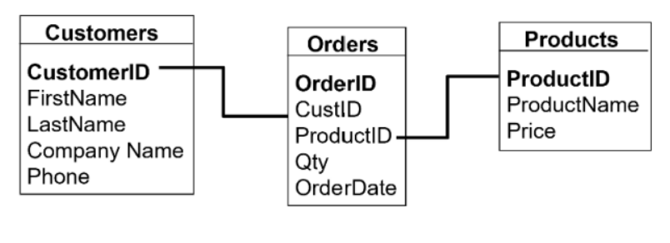
Foreign Key
Foreign Key
Primary Key
Primary Key
Parent Table
Parent Table
Child Table

Slide 140
Constraints

Slide 141
What is Constraints?
SQL constraints are used to specify rules for data in a table.
Constraints are used to limit the type of data that can go into a table.
This ensures the accuracy and reliability of the data in the table.
If there is any violation between the constraint and the data action, the action is aborted.
Constraints can be column level or table level.
Constraints can be specified when the table is created with the CREATE TABLE statement, or after the table is created with the ALTER TABLE statement.

Slide 142
Constraints used in SQL
The following constraints are commonly used in SQL:
NOT NULL constraint - Ensures that a column cannot have a NULL value
UNIQUE KEY constraint - Ensures that all values in a column are different/unique
PRIMARY KEY constraint - A combination of a NOT NULL and UNIQUE. Uniquely identifies each row in a table
FOREIGN KEY constraint - Prevents actions that would destroy links between tables
CHECK constraint - Ensures that the values in a column satisfies a specific condition
DEFAULT constraint - Sets a default value for a column if no value is specified

Slide 143
NOT NULL Constraint
By default, a column can hold NULL values.
The NOT NULL constraint enforces a column to NOT accept NULL values.
This enforces a field to always contain a value, which means that you cannot insert a new record, or update a record without adding a value to this field.
Example: Create a table “Person” in which "ID", "LastName", and "FirstName" columns will NOT accept NULL values.
Example: Create a NOT NULL constraint on the "Age" column when the "Persons" table is already created.
Example
CREATE TABLE Persons (
ID int NOT NULL,
LastName varchar(255) NOT NULL,
FirstName varchar(255) NOT NULL,
Age int );
Example
ALTER TABLE Persons
ALTER COLUMN Age int NOT NULL;

Slide 144
CHECK Constraint
The CHECK constraint is used to limit the value range that can be placed in a column.
If you define a CHECK constraint on a column it will allow only certain values for this column.
Example: Create a table “Person” with CHECK constraint on the "Age" column. The CHECK constraint ensures that the age of a person must be 18, or older:
Example: Create a CHECK constraint on the "Age" column when the "Persons" table is already created.
Example
CREATE TABLE Persons (
ID int NOT NULL,
LastName varchar(255),
FirstName varchar(255) NOT NULL,
Age int CHECK (Age>=18)
);
Example
ALTER TABLE Persons
ADD CHECK (Age>=18);

Slide 145
DEFAULT Constraint
The DEFAULT constraint is used to set a default value for a column.
The default value will be added to all new records, if no other value is specified.
Example: Create a table “Person” with DEFAULT constraint on the "Age" column. The DEFAULT constraint will insert default age of a person as 18:
Example: Create a DEFAULT constraint on the "Age" column when the "Persons" table is already created.
Example
CREATE TABLE Persons (
ID int NOT NULL,
LastName varchar(255),
FirstName varchar(255) NOT NULL,
Age int DEFAULT 18
);
Example
ALTER TABLE Persons
ADD CONSTRAINT df_Age
DEFAULT 18 FOR Age;

Slide 146
UNIQUE KEY
The UNIQUE constraint ensures that all values in a column are different/Unique.
Both the UNIQUE KEY and PRIMARY KEY constraints provide a guarantee for uniqueness for a column or set of columns.
However, you can have many UNIQUE KEY per table, but only one PRIMARY KEY per table.
Example: Create a table “Person” with UNIQUE KEY on the "ID" column:
Example: Create a UNIQUE KEY on the “ID" column when the "Persons" table is already created.
Example
Example
UNIQUE KEY on multiple columns
CREATE TABLE Persons (
ID int NOT NULL UNIQUE,
LastName varchar(255),
FirstName varchar(255) NOT NULL,
Age int
);
CREATE TABLE Persons (
ID int NOT NULL,
LastName varchar(255),
FirstName varchar(255) NOT NULL,
Age int,
CONSTRAINT UC_Person UNIQUE (ID,FirstName)
);
Example
Example
UNIQUE KEY on multiple columns
ALTER TABLE Persons
ADD UNIQUE (ID);
ALTER TABLE Persons
ADD CONSTRAINT UC_Persons UNIQUE (ID,FirstName);

Slide 147
PRIMARY KEY
The PRIMARY KEY constraint uniquely identifies each record in a table.
Primary keys must contain UNIQUE values, and cannot contain NULL values.
A table can have only ONE primary key; and in the table, this primary key can consist of single or multiple columns (fields).
Example: Create a table “Person” with PRIMARY KEY on the "ID" column:
Example: Create a PRIMARY KEY on the “ID" column when the "Persons" table is already created.
Example
Example
PRIMARY KEY on multiple columns
CREATE TABLE Persons (
ID int NOT NULL PRIMARY KEY,
LastName varchar(255),
FirstName varchar(255) NOT NULL,
Age int
);
CREATE TABLE Persons (
ID int NOT NULL,
LastName varchar(255),
FirstName varchar(255) NOT NULL,
Age int,
CONSTRAINT PK_Person PRIMARY KEY (ID,FirstName) );
Example
Example
PRIMARY KEY on multiple columns
ALTER TABLE Persons
ADD PRIMARY KEY (ID);
ALTER TABLE Persons
ADD CONSTRAINT PK_Person PRIMARY KEY (ID,FirstName);

Slide 148
FOREIGN KEY
The FOREIGN KEY constraint is used to prevent actions that would destroy links between tables.
A FOREIGN KEY is a field (or collection of fields) in one table, that refers to the PRIMARY KEY in another table.
The table with the foreign key is called the child table, and the table with the primary key is called the referenced or parent table.
Example: Create a table “Order” with FOREIGN KEY on the “Person ID" column:
Example: Create a FOREIGN KEY on the “ID" column when the “Order" table is already created.
Example
CREATE TABLE Orders (
OrderID int NOT NULL PRIMARY KEY,
OrderNo int NOT NULL,
PersonID int FOREIGN KEY REFERENCES Persons(PersonID) );
Example
ALTER TABLE Orders
ADD FOREIGN KEY (PersonID) REFERENCES Persons(PersonID);

Slide 149
Thank You

